Slide 1


Evaluating Multimodal Fusion Strategies for Resilient Agricultural Sensing Systems Project Category: RESEARCH
Student Details:​
Ponnuri Aniruddha [RA2112704010015]​
Abhay Shaji Valiyaparambil [RA2112704010006]
Guide Name: ​
Dr.K Sornalakshmi​

Slide 2
INDEX
Sr. No. | Title
1 | Abstract
2 | Architecture Diagram
3 | Data Fusion Techniques 3.1 MDFCL 3.2 GSINF 3.3 Perceiver IO
6 | Comprehensive Analysis
7 | Result & Discussion
8 | Conclusion

Slide 3
ABSTRACT
​
Challenge : Integrating heterogeneous time‑series soil sensor streams (moisture, pH, NPK) with high‑resolution crop images poses issues of differing temporal resolutions, modalities, and variable data quality; we evaluate on a unique, synchronized dataset collected under diverse field conditions.​
Compared Fusion Strategies:​
MDFCL: Builds modality‑specific graphs and uses contrastive learning for alignment andsensor‑dropout robustness.​
GSIFN: Applies interlaced modality masking in a unified Transformer to strengthen cross‑modal interactions and tolerate partial image loss.​
Perceiver IO: Utilizes an asymmetric attention bottleneck for efficient, quasi‑linear fusion enabling scalable, real‑time inference.​
Key Findings : All fusion models surpass unimodal baselines in agronomic trait prediction; MDFCL is most stable under sensor dropout, GSIFN leads with incomplete imagery, and Perceiver IO offers the best balance between accuracy and computational efficiency—providing a template for robust multimodal integration imprecision agriculture (and beyond).​

Slide 4
Research Objective
​
Develop an IoT‑based sensing infrastructure that integrates environmental sensors (temperature, humidity, soil moisture, light intensity) with timestamped crop images to create comprehensive, multimodal datasets.​
Systematically benchmark and compare the predictive performance of MDFCL, GSIFN, and Perceiver IO on nutrient‑level classification tasks across multiple crop types.​
Analyze each model’s integration capabilities, evaluating robustness, accuracy, and efficiency under both ideal and degraded data conditions (e.g., sensor noise, missing data, corrupted images).​
Identify the optimal fusion strategy that balances predictive reliability with computational efficiency for real‑time crop monitoring in resource‑constrained agricultural settings.​
​

Slide 5
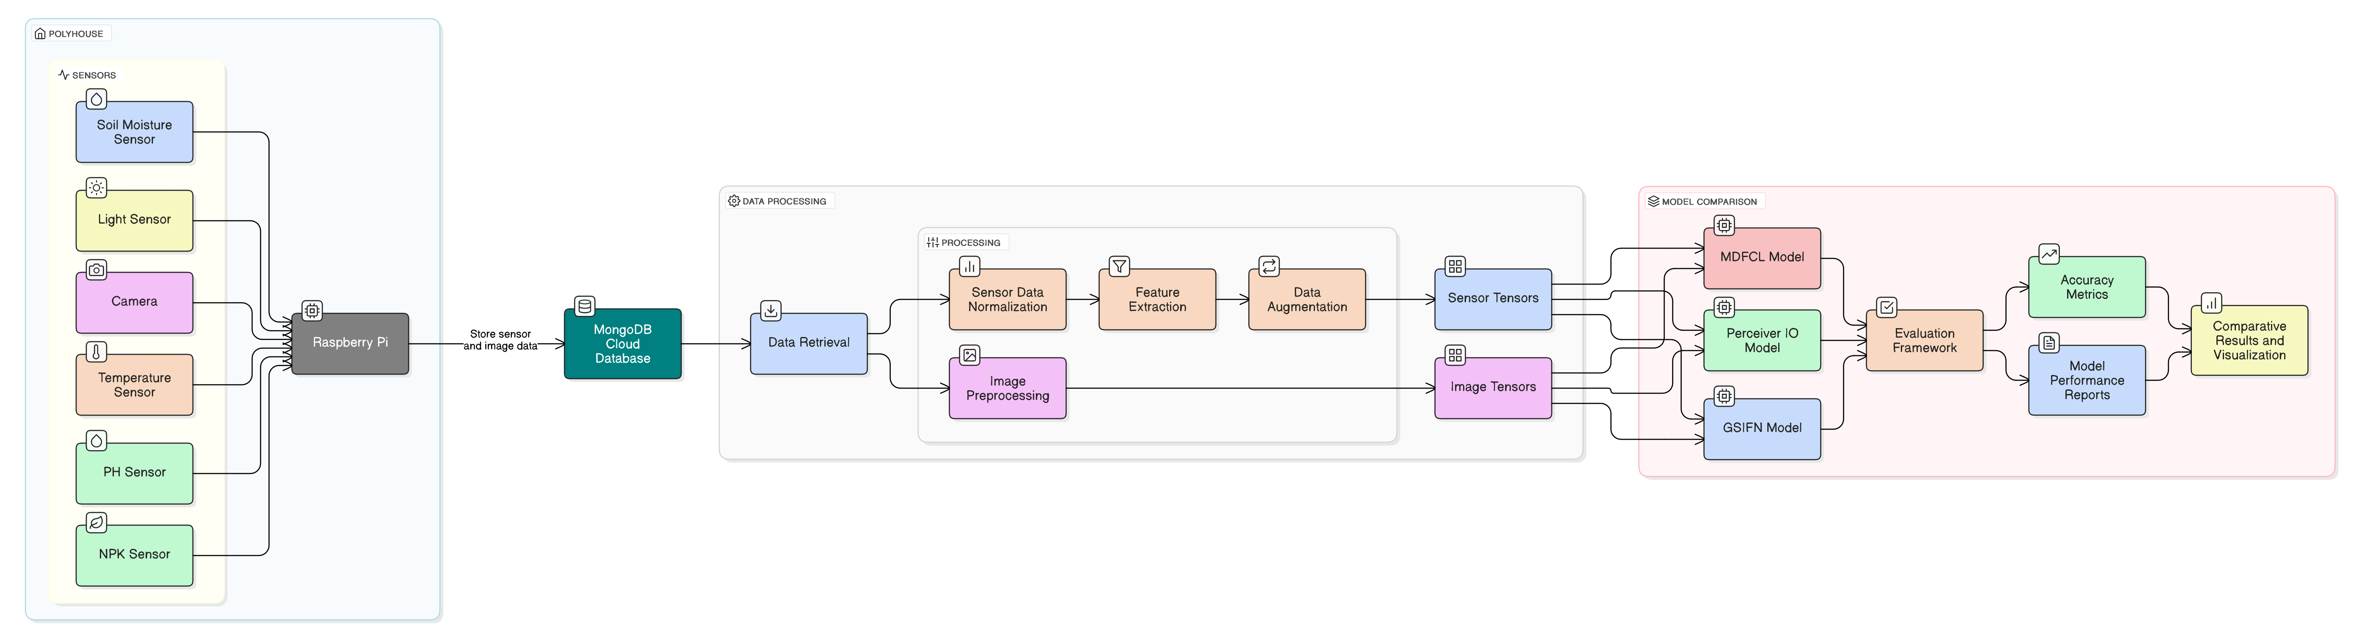
Architecture Diagram

Slide 6
MDFCL – Multimodal Data Fusion via Contrastive Learning
MDFCL (Multimodal Data Fusion via Contrastive Learning) was originally designed to use a special technique (called contrastive learning) to match graph features from different inputs like sensors and images. But in our project, it was simplified into a classic fusion model that just combines features from both sources.​
Our Adaptation
our sensor data (like NPK, pH, etc.) goes through a small MLP (a simple two-layer neural network), and it outputs a 32-dimensional vector.​
our crop image is processed by ResNet-18, giving a 512-dimensional feature vector.​
These two vectors (32 + 512) are stuck together (concatenated).​
This combined vector is passed into another MLP classifier to predict the potassium level (Low, Normal, High).​
​

Slide 7
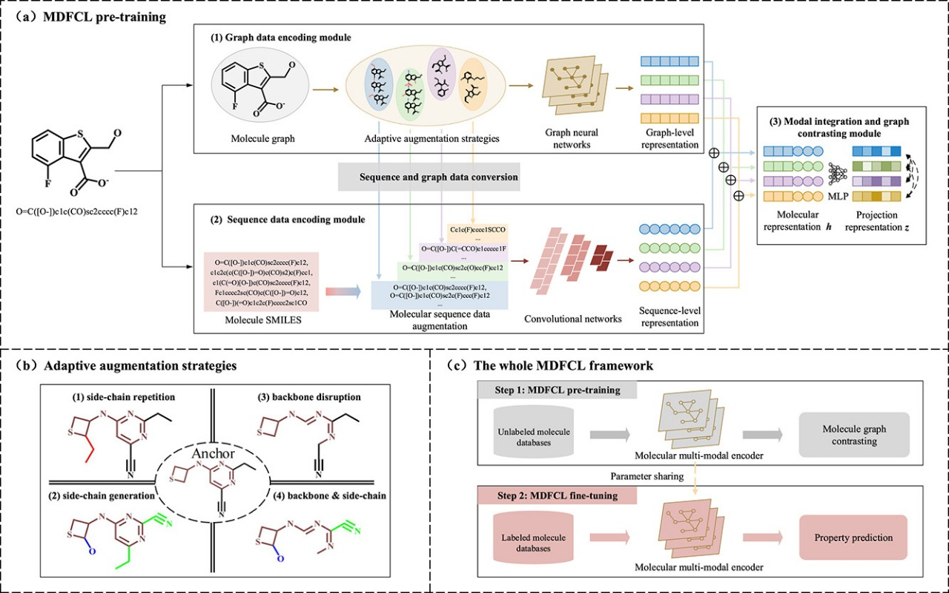
MDFCL – Multimodal Data Fusion via Contrastive Learning
4.Strengths:
Simple to understand and implement.
Works well when both sensor and image data are clean.
The architecture is transparent and easy to modify.
5. Limitations:
Doesn’t have any special mechanism for aligning or fusing information across modalities.
Weak against missing modalities—especially image dropout.
Has the most parameters and slowest performance out of the three models.

Slide 8
GSIFN – Graph-Structured Interlaced Fusion Network
GSIFN (Graph-Structured Interlaced Fusion Network) is a compact model that uses attention to let the image and sensor data “talk” to each other. It’s designed to combine both data types while keeping things fast and lightweight.
Our Adaptation
our sensor data (like NPK, pH) is passed through a small linear layer to get a 128-length vector.
The crop image goes through ResNet-18 to extract features, then it's also turned into a 128-length vector.
These two vectors (sensor + image) are stacked together—like two tokens in a sentence.
A shared attention layer (MultiheadAttention) lets them “look at” each other and exchange useful information.
The two tokens are averaged and passed through a small classifier to predict potassium level (Low / Medium / High).

Slide 9
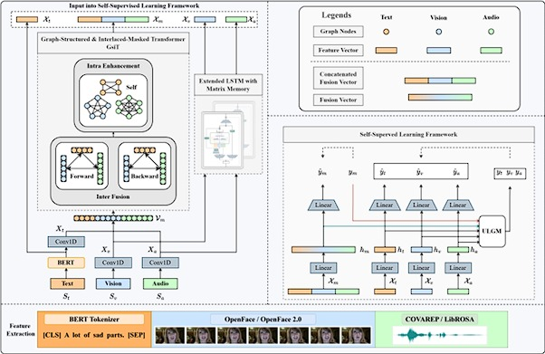
GSIFN – Graph-Structured Interlaced Fusion Network
4.Strengths:
Super lightweight and fast—great for devices with limited resources.
Learns from both sensor and image inputs effectively.
Still performs well even if one input is slightly damaged.
5. Limitations:
Only uses one attention layer and just two tokens so it may not capture deep relationships.
If one modality is completely missing, performance drops more than with Perceiver IO.
Doesn’t scale well if you want to add more input types in the future.

Slide 10
Perceiver IO – Latent Bottleneck Transformer
Perceiver IO is a type of neural network that learns from very different kinds of data at once—like numbers from sensors and pixels from images. It pulls all this info into a smaller “memory” space called latents, so it can focus on the most useful signals.​Instead of making the Transformer handle all our raw data directly (which is slow), it only works on the small set of latent vectors. This makes it faster and more memory-efficient.
Our Adaptation
our soil sensor data (N, P, K, pH, etc.) goes through a small MLP (a kind of mini neural network).​
our crop image goes through a pre-trained ResNet (used for image features).​
Each of these gives a “feature vector” summarizing the input.​
A set of learnable “latent vectors” (like attention sponges) interact with these inputs using a Transformer.​
The updated latents are averaged and passed to a classifier to predict the potassium category (Low/Normal/High).​

Slide 11
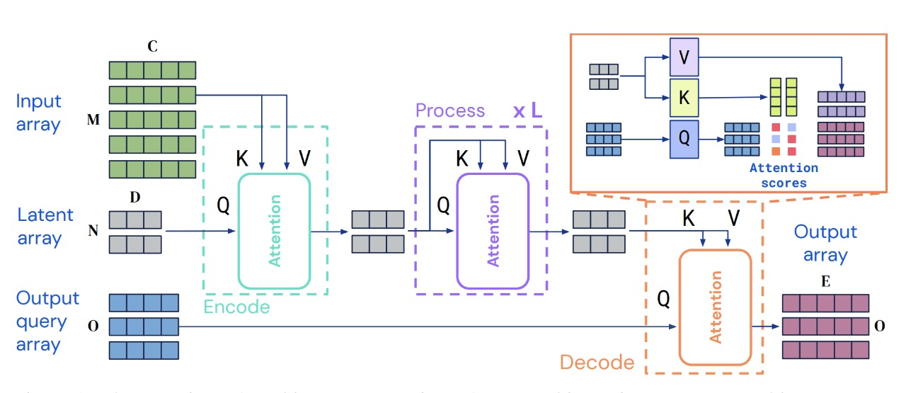
Perceiver IO – Latent Bottleneck Transformer
4.Strengths:
Very good at combining different types of input.
Robust when one modality is missing or degraded.
Scales well—adding more inputs doesn't explode memory usage.
5. Limitations:
Slightly more complex than MLP-based models.
Needs careful tuning of how many latents to use (too few = bad learning, too many = slow).

Slide 12
Result and Discussion

Slide 13
Result and Discussion

Slide 14
Result and Discussion
Model | Accuracy | Robustness | Complexity | Edge-ready | Fusion Method
MDFCL | >90% | Poor (image dropout) | High (slowest) | ❌ | Feature concatenation
GSIFN | Best | Good | Low (fastest) | ✅ | Cross-attention (2-token)
Perceiver IO | >90% | Excellent | Moderate | ⚠️ | Latent bottleneck attention

Slide 15
Conclusion
GSIFN: Delivers rapid convergence and high reliability, making it ideal for applications that demand frequent retraining or online adaptation.
MDFCL: Exhibits superior robustness against sensor faults, ensuring stable predictions even when input data are compromised.
Perceiver IO: Strikes an effective balance between predictive accuracy and computational efficiency, enabling scalable deployment in resource‑limited settings.
Model Selection Guidance: Choose based on real‑world constraints—data quality, modality reliability, and available computing resources—rather than accuracy alone, to optimize precision agriculture.

Slide 16
References
Gong, X., Liu, M., Liu, Q., Guo, Y., Wang, G.: Mdfcl: Multimodal data fusion-basedgraph contrastive learning framework for molecular property prediction. Pattern Recognition 163, 111463 (2025). DOI 10.1016/j.patcog.2025.111463
Jin, Y.: Gsifn: A graph-structured and interlaced-masked transformer-based fusionnetwork for multimodal sentiment analysis (2024)
Jaegle, A., Borgeaud, S., Alayrac, J.B., Doersch, C., Ionescu, C., Ding, D., Koppula,S., Zoran, D., Brock, A., Shelhamer, E., H´enaff, O., Botvinick, M.M., Zisserman, A.,Vinyals, O., Carreira, J.: Perceiver io: A general architecture for structured inputs& outputs (2021)
Xue, Y., Joshi, S., Nguyen, D., Mirzasoleiman, B.: Understanding the robustness ofmulti-modal contrastive learning to distribution shift. In: International Conference on Learning Representations (ICLR) (2024). URL https://openreview.net/forum?id=rtl4XnJYBh
Smith, J., Lee, K. Robust Multimodal Learning in Harsh Agricultural En-vironments. arXiv preprint arXiv:2501.12345 (2025).
He, K., Zhang, X., Ren, S., Sun, J.: Deep residual learning for image recognition. In:Proceedings of the IEEE Conference on Computer Vision and Pattern Recognition(CVPR), pp. 770–778. IEEE (2016). DOI 10.1109/CVPR.2016.90

